Slide 1
CREDIT CARD APPROVAL SYSTEM
By
Gokulnath - (19I217)
Aswath – (19I205)
Pragadheesh – (19I241)
Suriya Prakash – (19I255)
Tharunraj – (19I208)

Slide 2
Credit Card Management System
The Card Management System is a Windows based application that takes care of the complete internal Card Processing activities of a Bank (management and maintenance of cards).
It is suitable for the management of Debit Cards, Credit Cards as well as Smart Cards. It mainly involves the maintenance and management of card – related information in a Bank.
This product caters to all the Credit, Debit and Smart Card based functions of a bank like Registration of Customers for card issue, Opening Card Accounts for the registered customer, Creation of Cards for registered customers, Hot Carding, making the Card ready for Embossing by creation of Card Data file etc.
The Card Management System could interact with an external Card Transaction System, thereby making the Card-related information maintained by the bank, up-to-date. The purpose is to build a Card Management System which provides complete card processing, to meet the needs of full-fledged Credit card and Debit card based ATM or Point of Sale network.

Slide 3
PROPOSED SYSTEM
The proposed system is designed to change the existing system into more effective.
It makes the customer easier to get a cash. The Card Management System could interact with an external Card Transaction System, thereby making the Card-related information maintained by the bank, up-to-date.
The purpose is to build a Card Management System which provides complete card processing, to meet the needs of full-fledged Credit card and Debit card based ATM or Point of Sale network. Customer can apply for credit card and know his eligibility from his own place just by giving his personal details.

Slide 4

Module Description
Admin Module:
Credit Card Creation
Transaction process
Modify Customer Details
Customer Details

Slide 5
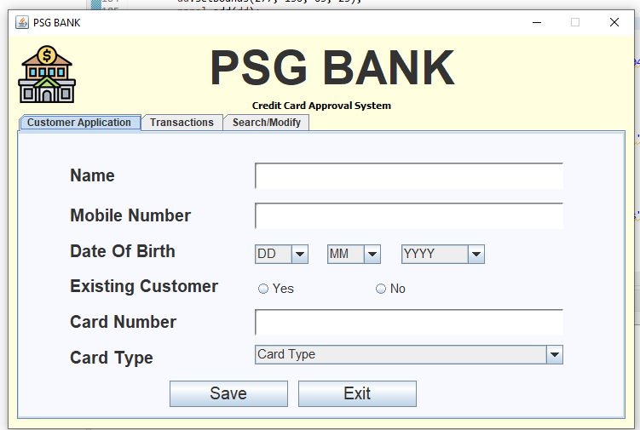
Credit Card Creation

Slide 6
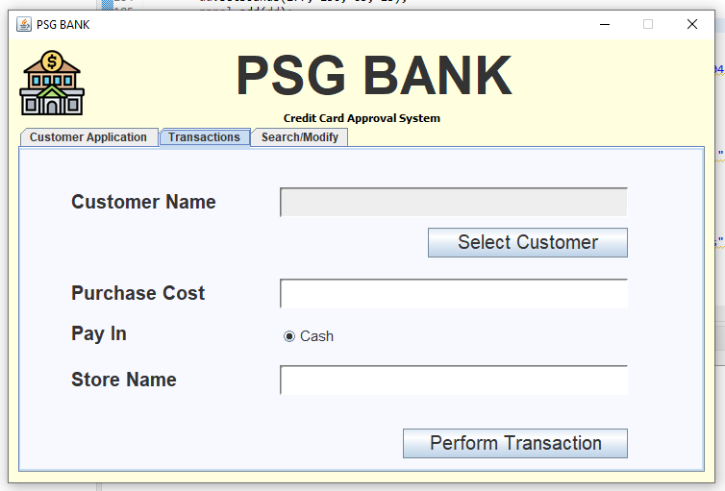
Transaction process

Slide 7
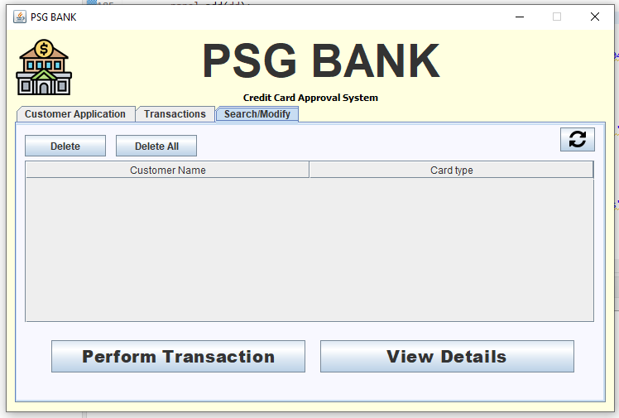
Modify Customer Details

Slide 8
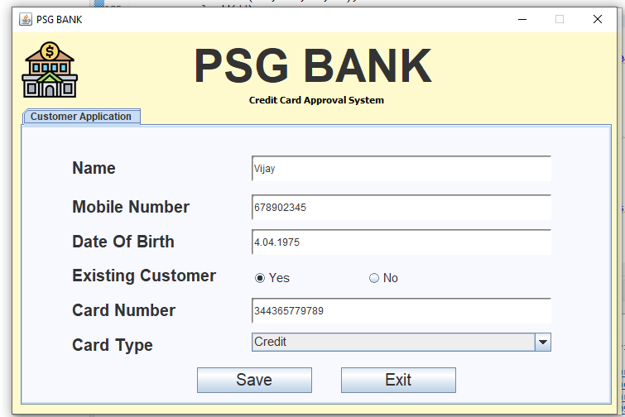
Customer Details

Slide 9
PACKAGES AND CLASSES
Packages:
java.awt.event.* - event package defines classes and interfaces used for event handling in the AWT and Swing.
javax.swing.* - provides interfaces that enable the development of input methods that can be used with any Java runtime environment.
java.sql.* - Provides the API for accessing and processing data stored in a data source (usually a relational database).

Slide 10
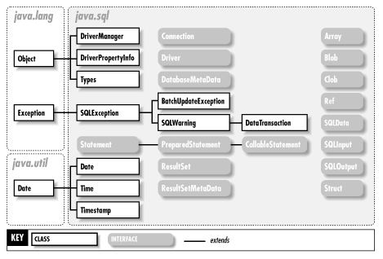
java.sql package
The java.sql package contains the entire JDBC API that sends SQL (Structured Query Language) statements to relational databases and retrieves the results of executing those SQL statements

Slide 11
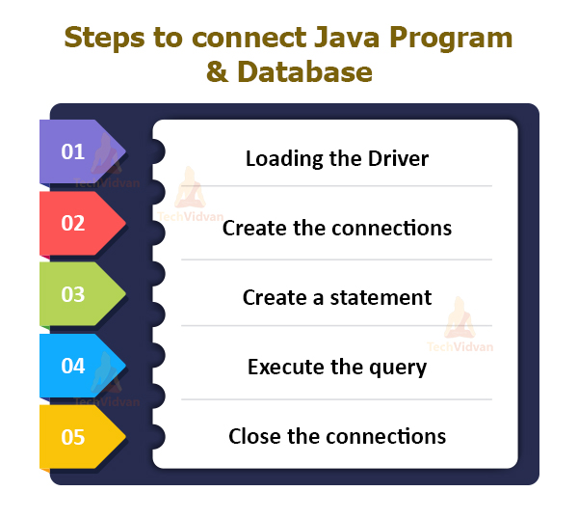
JDBC Connectivity

Slide 12
Java.awt package
EventQueue
EventQueue is a platform-independent class that queues events, both
from the underlying peer classes and from trusted application classes. There is
only one EventQueue for the system.
Color
The Color class creates color by using the given RGBA values where
RGBA stands for RED, GREEN, BLUE, ALPHA or using HSB value where
HSB stands for HUE, SATURATION, BRIcomponents.
Font
The Font class states fonts, which are used to render text in a visible
way. There are four styles for displaying fonts in Java: plain, bold, italic, and
bold italic

Slide 13
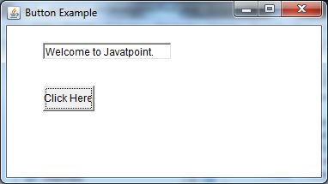
Java.awt event
ActionListener
The class that is interested in processing an action
event implements this interface, and the object created with
that class is registered with a component, using the
component's addActionListener method. When the action
event occurs, that object's actionPerformed method is
invoked.

Slide 14
MouseAdapter
The class MouseAdapter is an abstract (adapter)
class for receiving mouse events. All methods of this class are empty. This class
is convenience class for creating listener objects.
MouseEvent
This event indicates a mouse action occurred in a component. This low
level event is generated by a component object for Mouse Events and Mouse
Motion events.
ActionEvent
A semantic event which indicates that a component defined action
occurred. This high-level event is generated by a component (such as a Button )
when the component-specific action occurs (such as being pressed).

Slide 15
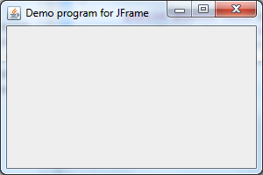
Java.swing.packages
BorderFactory:
BorderFactory is a Factory class which produces different types of
borders (Border instances).
JFrame:
The javax.swing.JFrame class is a type of container which inherits the
java.awt.Frame class. JFrame works like the main window where components like
labels, buttons, textfields are added to create a GUI.

Slide 16
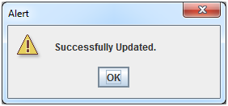
JOptionPane:
The JOptionPane class is used to provide standard dialog boxes such as message dialog box, confirm dialog box and input dialog box.
SwingConstants:
A collection of constants generally used for positioning and orienting
components on the screen

Slide 17
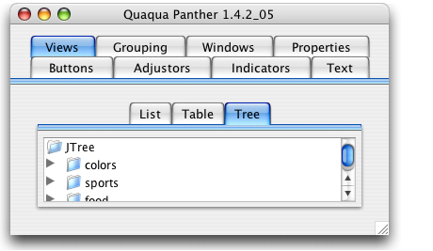
UIManager:
UIManager manages the current look and feel, the set of available look
and feels, PropertyChangeListeners that are notified when the look and feel
changes, look and feel defaults, and convenience methods for obtaining various
default values.
JTabbedPane:
The JTabbedPane class is used to switch between a group of
components by clicking on a tab with a given title or icon.

Slide 18
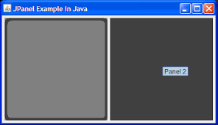
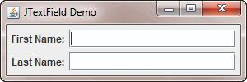
JPanel:
The JPanel is a simplest container class. It provides space in which
an application can attach any other component.
JTextFeild:
The object of a JTextField class is a text component that allows the
editing of a single line text

Slide 19
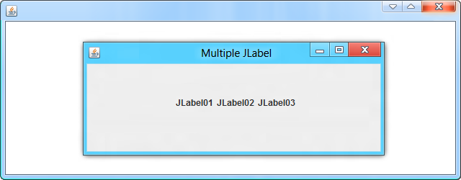
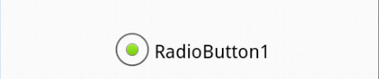
JLabel:
The object of JLabel class is a component for placing text in a
container. It is used to display a single line of read only text. The text can be
changed by an application but a user cannot edit it directly. It inherits
JComponent class.
JRadioButton:
The JRadioButton class is used to create a radio button. It is
used to choose one option from multiple options. It is widely used in exam
systems or quiz. It should be added in ButtonGroup to select one radio
button only.

Slide 20
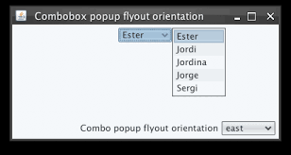
ImageIcon:
The class ImageIcon is an implementation of the Icon
interface that paints Icons from Images
JComboBox:
The object of Choice class is used to show popup menu of
choices. Choice selected by user is shown on the top of a menu.

Slide 21
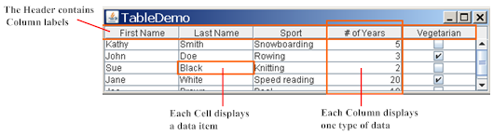
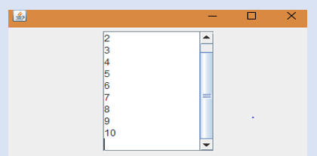
JTable:
The JTable class is used to display data in tabular
form. It is composed of rows and columns.
JScrollPane:
A JscrollPane is used to make scrollable view of a component. When
screen size is limited, we use a scroll pane to display a large component or a
component whose size can change dynamically.

Slide 22
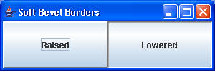
BevelBorder and SoftbevelBorder:
BevelBorder and SoftBevelBorder are a part of javax.swing.Border
package. This package contains different Border for Components. BevelBorder
is an implementation of a simple two line bevel border. Bevel Border and Soft
Bevel Border are almost same but Soft Bevel Border has softened corners.

Slide 23
Structured Query Language (SQL)
SQL is a standard language for storing, manipulating
and retrieving data in databases.
A step by step guide to using JDBC with Eclipse:
Step 1: Create an Eclipse Project
Step 2: Install the Connector/J JDBC driver
In this step, we install the Connector/J driver so our
program can connect to MySQL.
1.Go to this web page: http://www.mysql.com/downloads/connector/j/
2.Press the download button next to the “Platform Independent (Architecture Independent), ZIP Ar-chive” version. (Or the TAR version if you prefer; it doesn’t really matter.)

Slide 24
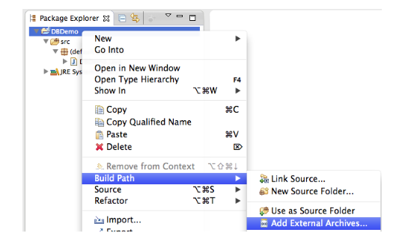
3.Open the .zip file you just downloaded, and look for a file inside
Named mysql-connector-java-5.1.24-bin.jar. Copy this file into your
project directory (from the Location box in step 3 of the last section).
4.Now that we have the driver, we need to tell your project about it. Go
back to Eclipse, right click on the project, and select Build Path → Add
External Archives...

Slide 25
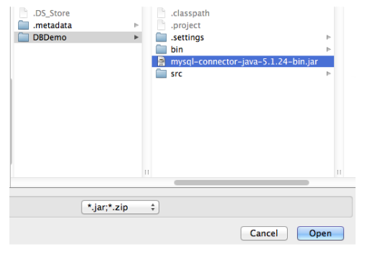
5.Select mysql-connector-java.5.1.24-bin.jar and press Open
6.Now we’re ready to configure the project for your copy of MySQL and run it!

Slide 26


